Slide 1
Manual LOA and Project Creation For Programme Manager

Slide 2
Document Versions
Version No | Date | Prepared By | Changes
1.0 | 20-June-2018 | Ervira R Suroto | Initial Version. Incorporated CR#32
1.1 | 30-July-2018 | Ervira R Suroto | Incorporated Consolidated Feedback on 24 July 2018
1.2 | 10-Aug-2018 | Ervira R Suroto | Incorporated Consolidated Feedback Received on 06 August 2018
1.3 | 27-Dec-2020 | Ramakrishna Gunisetty | Added slide 29 with validations for Research team tab. (Ref: INC000014802405)
1.4 | 03-June-2021 | Karen Mae Ong | Added slides 27 and 28 with steps in verifying the Research Team Contact ID
1.5 | 24-Aug-2021 | Hendrianto | Incorporated CR COMM-2020E-0012

Slide 3
Document Versions
Version No | Date | Prepared By | Changes
1.6 | 18-Sep-2021 | Karen Mae Ong | Added instructions on how to specify different IDC and Co-funding amounts for multiple HIs

Slide 4
Definitions, Acronyms and Abbreviations
Sl. No | Abbreviation / Acronyms | Definitions
1 | PI | Principal Investigator
2 | PM | Programme manager
3 | AF | Agency Finance
4 | HI | Host Institution
5 | LOA | Letter of Award
6 | ORE | Officer of Research
7 | DOR | Director of Research
8 | AI ORE | Academic Institution Office of Research
9 | AI DOR | Academic Institution Director of Research
10 | HI Finance | Host Institution Finance
11 | HI HR | Host Institution Human Resources
12 | RGO | Research Grant Office
13 | FR | Fund Requisition

Slide 5
Learning Objectives
In this session, you will learn :
Overview and Navigation of IGMS
In this module you will learn how navigate IGMS as a Project Manager and general shortcuts.
Generate Project from Manual LOA
In this module you will learn how to generate a project directly without going through the pre-award processes, such as proposal submission, evaluation, and scrubbing.

Slide 6
Overview and Navigation of IGMS
Overview and Navigation of IGMS
Generate Project from Manual Letter of Award

Slide 7
Login in IGMS

Slide 8
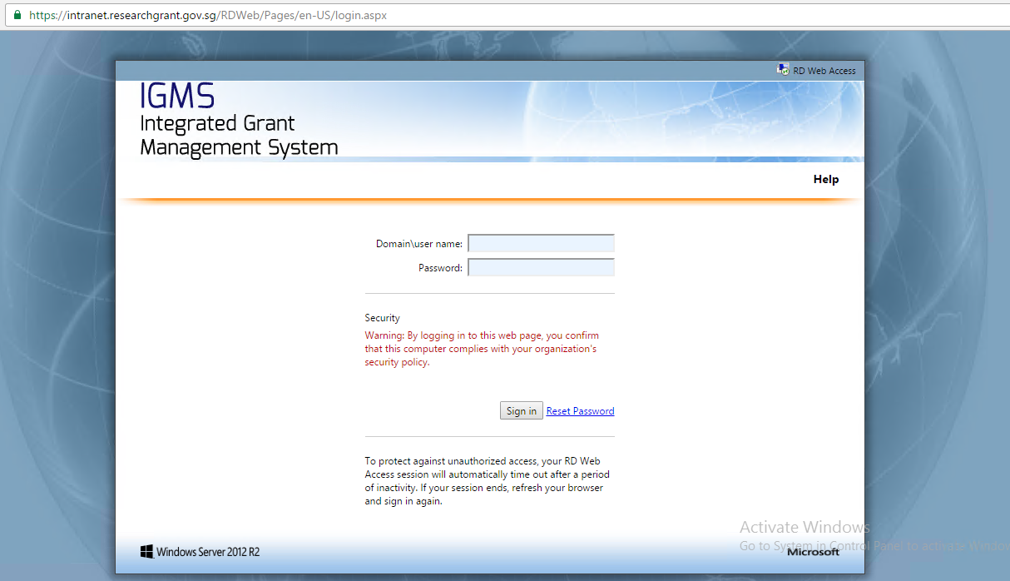
Overview and Navigation of IGMS
To connect to IGMS for PM and Agency Finance, open web browser and go to this address :
For Production (After Go Live)
https://intranet.researchgrant.gov.sg/
For Testing (UAT)
https://intranet.uat.researchgrant.gov.sg/

Slide 9
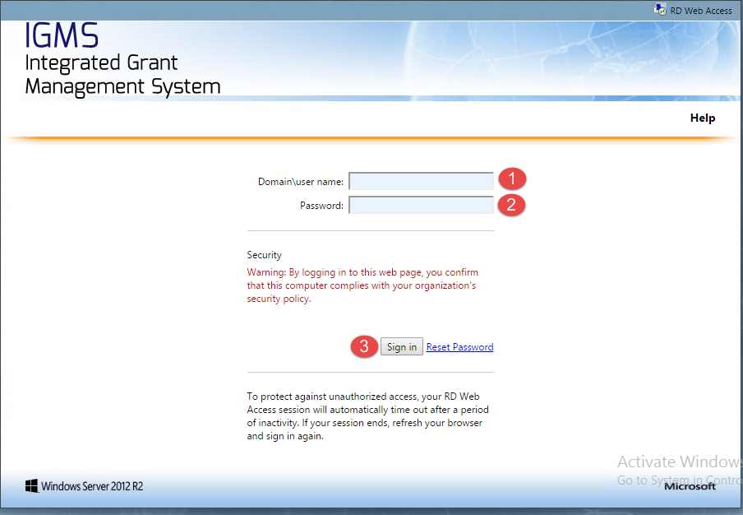
Overview and Navigation of IGMS
1
Key in domain followed by \ (back slash) and your user name
For Production (After Go Live)
Researchgt\
For Testing (UAT)
Uatresearchgt\
Key in the password
Click sign in to continue
2
3

Slide 10
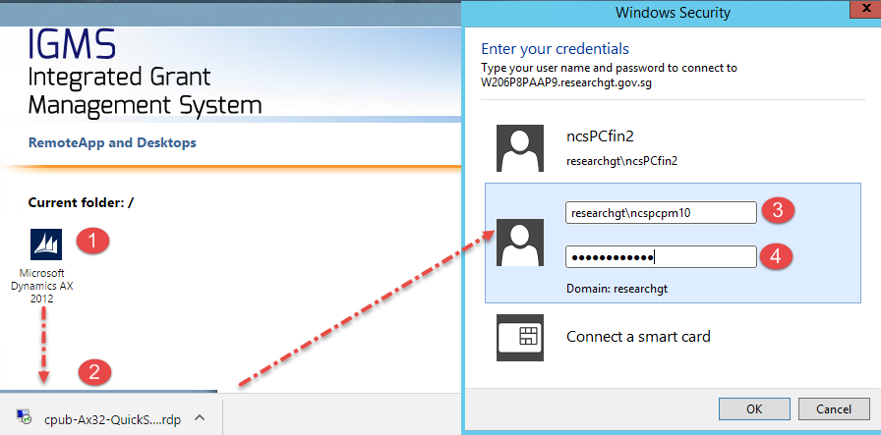
Overview and Navigation of IGMS
1
Click the Dynamics AX sign
Browser will download the file, Click / open downloaded file by browser
Key in one more time domain followed by back slash, user name
Key in the password
2
3
4

Slide 11
IGMS Menu and Navigation

Slide 12
Overview and Navigation of IGMS
1
TITLE BAR
This standard feature is to display:
The application name
The license name
The server name
Workspace instance
A minimize button
A maximize/restore button
A close button
1

Slide 13
Overview and Navigation of IGMS
2
BREADCRUMB BAR
The Breadcrumb bar (BCB) gives user a “breadcrumb” trail of where in the program he or she has been and how to get back.
ACTION PANE
This standard Windows feature contains a row of icons to provide quick access to frequently used functions such as editing and locating data
2
3
3

Slide 14
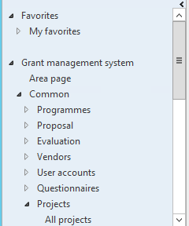
Overview and Navigation of IGMS
4
NAVIGATION PANE
The Navigation pane provides access to modules and functionality in IGMS. It includes the following parts:
My Favourites
Module buttons
4

Slide 15
Overview and Navigation of IGMS
5
Fast Tab
Is a tab within a form that expandable for stored details data
Tab
Is a tab in form to view other related information
5
6
6

Slide 16
Overview and Navigation of IGMS
FREQUENTLY USED SHORTCUT
Find, Filter and Export Data
SI. No | To Do This | Press
1 | Filter data by the current column (Filter dialog) | CTRL+K
2 | Define fields and values to filter on (Query dialog) | CTRL+F3
3 | Perform a global search (Find dialog) | CTRL+F
4 | Remove the current filter | CTRL+SHIFT+F3
5 | Create filters across all columns in a grid | CTRL+G
6 | Export the data in a grid to Microsoft Office Excel | CTRL+T
7 | Create new record | CTRL+N
8 | Refresh form to display the latest value | F5
9 | Delete Record | ALT+F9

Slide 17
Overview and Navigation of IGMS
FREQUENTLY USED SHORTCUT
Advance Filter and Query Options
SI. No | To Do This | Press
1 | Today’s date | T
2 | Range Value (From – To) | ..
3 | Value contains (in the front, middle, or last) in search criteria | *
4 | Exclude value | !
5 | Null / Blank Value | “”
6 | Having one or more unknown characters | ?
7 | Greater than value entered | > xx
8 | Lesser than value entered | < xx

Slide 18
General Overview
Overview and Navigation of IGMS
Generate Project from Manual Letter of Award

Slide 19
Generate Manual LOA

Slide 20
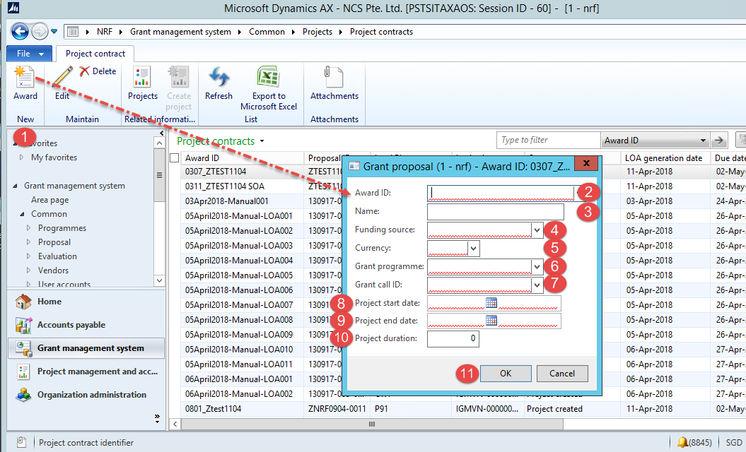
Generate Project From Manual Letter of Award
1
To generate a project from manual letter of award, navigate to Grant Management System > Common > Projects > Project Contracts and click the New Award button.
Key in award ID
Key in unique ID for LOA, you may key in same as award ID
Select Funding Source
Select Currency
2
3
4
5
Important Notes:
This module does not allow draft deletion or amendments to be made once user starts the process of manual LOA generation.

Slide 21
Generate Project From Manual Letter of Award
6
Select Grant Programme.
Select Grant Call ID.
Key in Project Start Date.
Key in Project End date.
Project duration is by default calculated by system.
Click OK to continue.
7
8
9
10
11

Slide 22
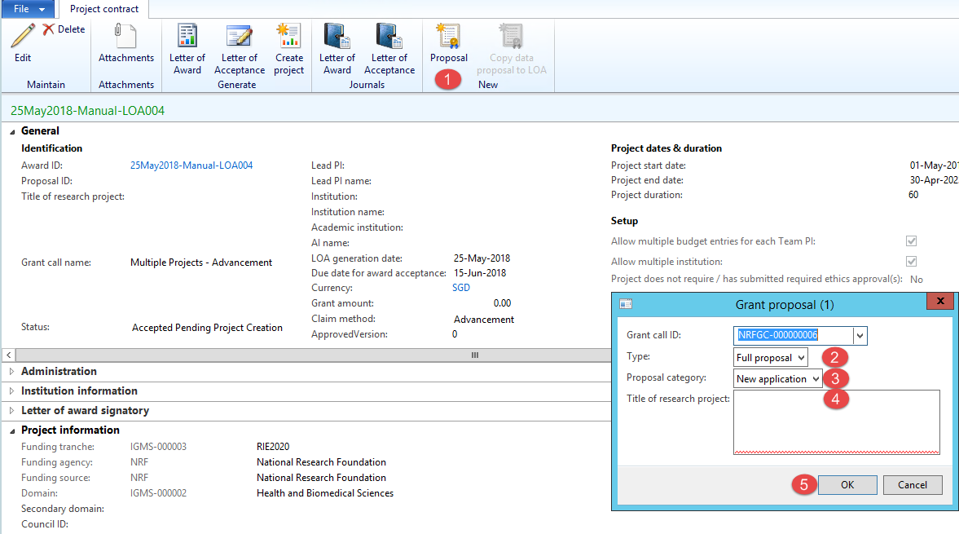
Generate Project From Manual Letter of Award
1
In the LOA form, click create New Proposal.
In the dialog box shown, select proposal type.
Select proposal category whether this is a new application, renewal or resubmission
Key in title research of project
Click OK button to continue
2
3
4
5

Slide 23
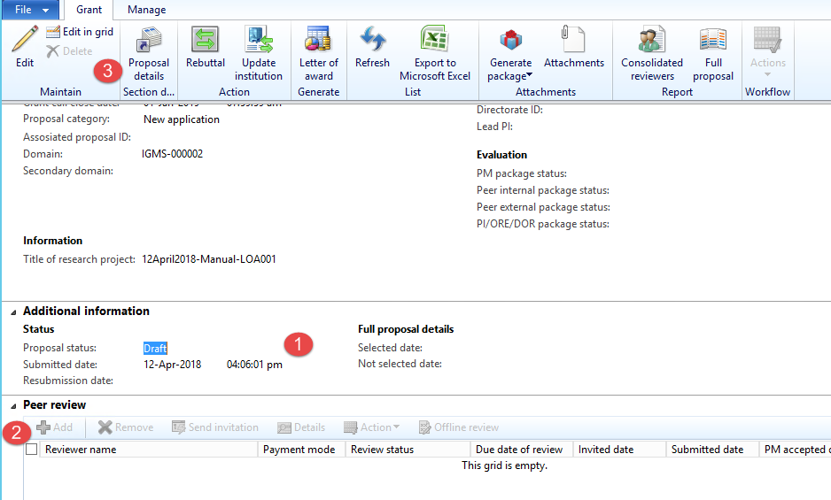
Generate Project From Manual Letter of Award
1
In the Proposal form, PM needs to key in the proposal information manually. The initial proposal status is Draft. After it created as a project, the status will updated to Project Created.
When generating a Project from Manual Letter of Award, some stages in pre-award will be skipped. Therefore PI submission, Evaluation and Scrubbing will not be applicable.
2
3
To key in the proposal details, click Proposal details button.

Slide 24
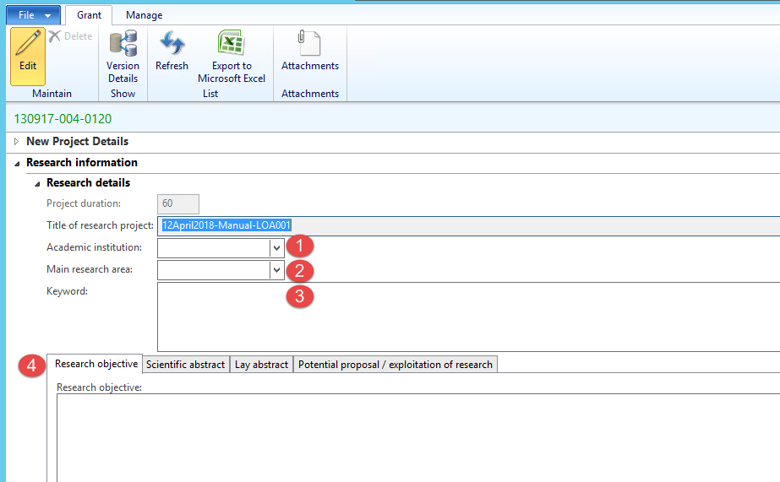
Generate Project From Manual Letter of Award
1
Some sections in the proposal section details are required, such as research information fast tab. If the Grant Call is setup to allow Academic Institution, the field academic institution will be enabled.
Select main research area.
Key in research keyword.
Key in research objectives, scientific abstract, lay abstract, potential proposal/exploitation of research.
2
3
4

Slide 25
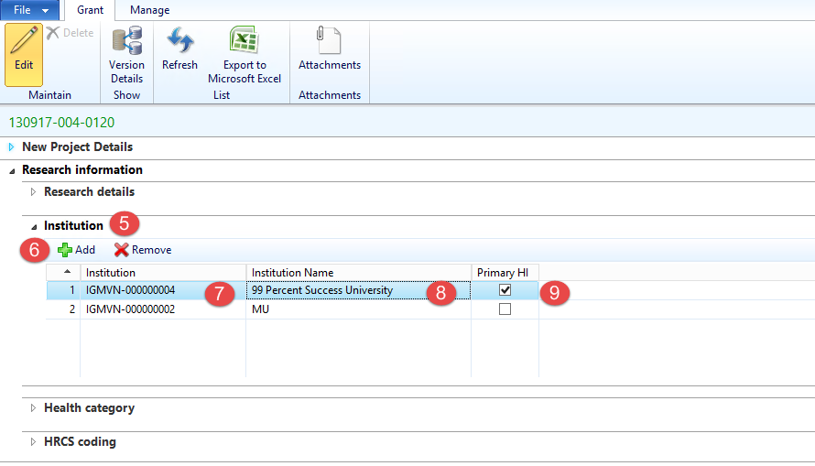
Generate Project From Manual Letter of Award
5
Open institution fast tab
Click the Add button
Select the main Host Institution
Institution name is auto populated
The first institution selected is by default set as Primary HI. Ensure this is the same Institution of the Lead PI.
6
7
8
9
Notes:
For single institution grant call, you can only add one Institution.

Slide 26
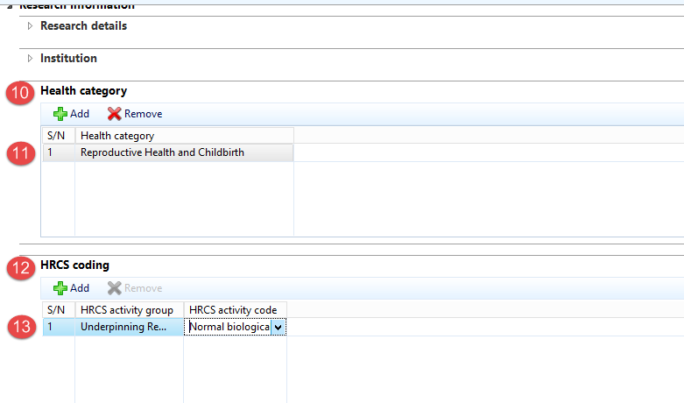
Generate Project From Manual Letter of Award
10
For a particular proposal, open Health Category,
And specify health category
Open HRCS coding,
And specify HRCS coding for the proposals.
11
12
13

Slide 27
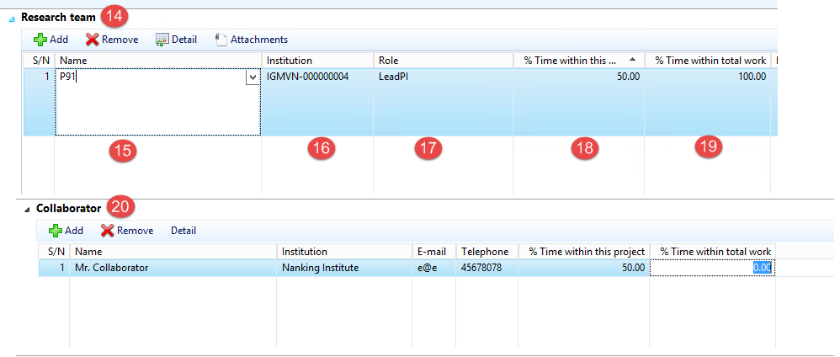
Generate Project From Manual Letter of Award
14
Open research team fast tab.
Select contact name for lead PI, team PI and other research team members.
Select institution for each research team
Select role
Key in %time within this project
Key in %time within total work
Key in the Collaborator for the research project.
15
16
17
18
19
Notes:
Lead PI should have the same Institution as the Proposal’s Institution (refers to the “Primary” Institution).
20

Slide 28
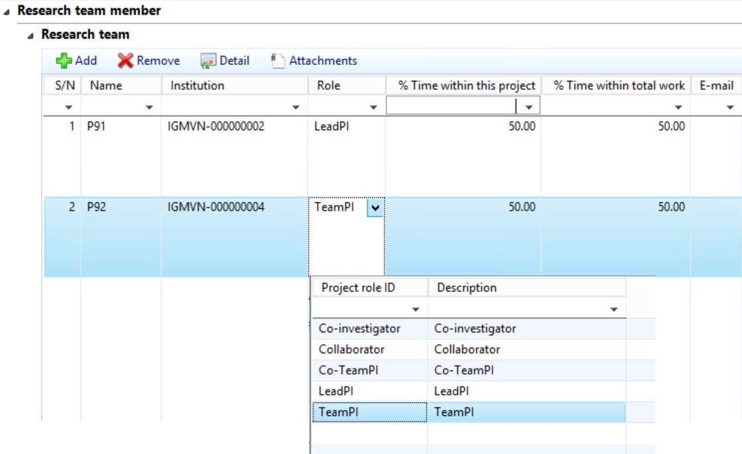
Generate Project From Manual Letter of Award
Notes:
If there are other institutions involved, which require budget and may qualify for different levels of Indirect Costs and Co-funding, add them as Team PIs, so that they can have separate budgets and claims can be made correctly.
1
1

Slide 29
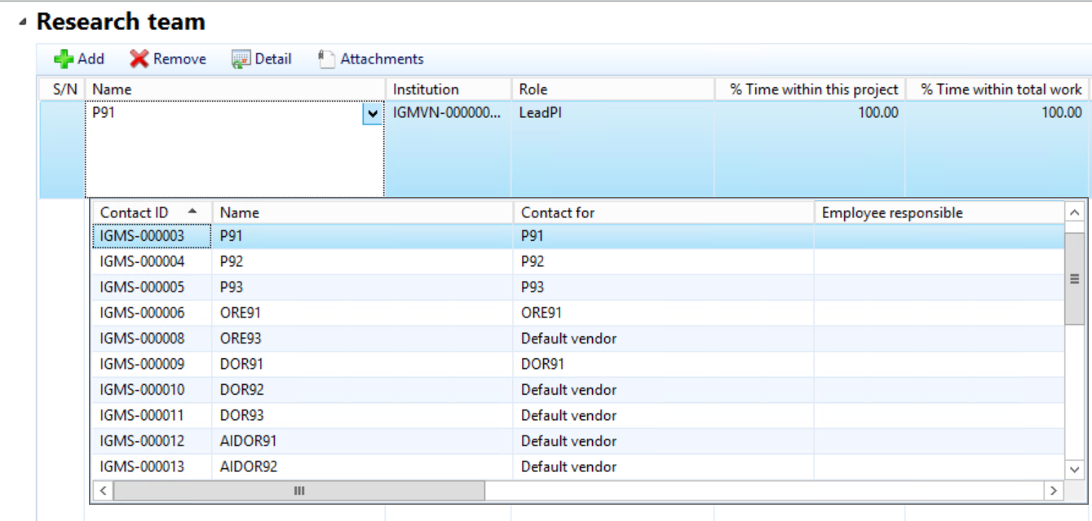
Generate Project From Manual Letter of Award
Notes:
1
To ensure that the PI selected is correct, the PM can perform verification by getting the Contact ID and checking it against the list of existing users accounts.
1

Slide 30
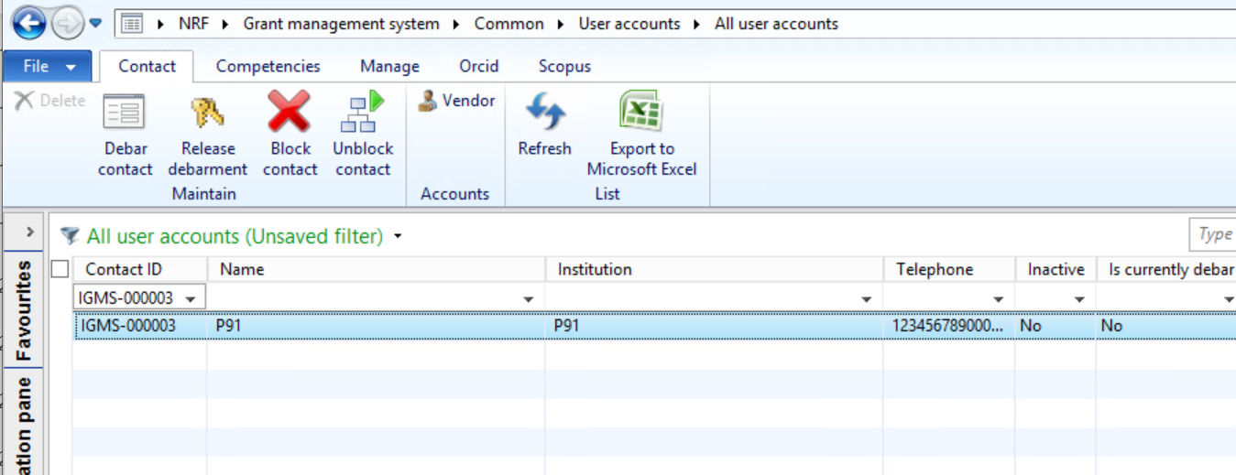
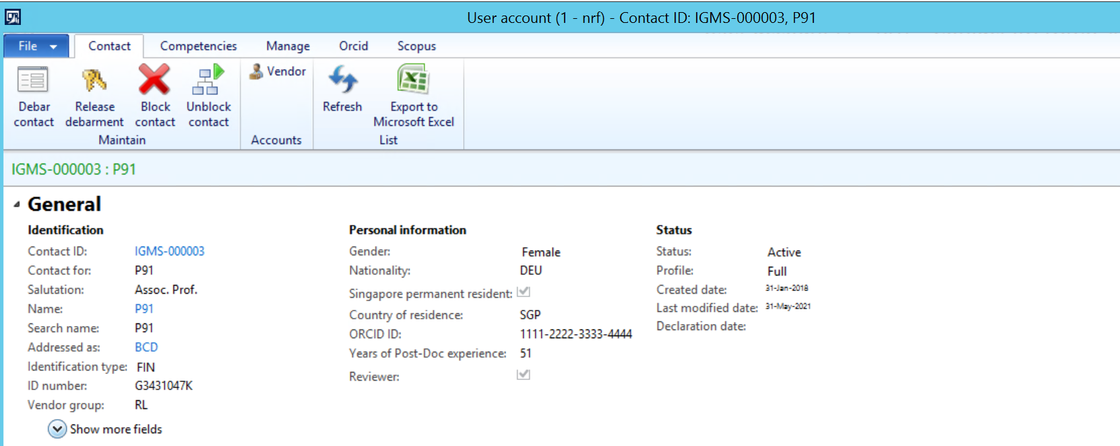
Generate Project From Manual Letter of Award
2
Go to the ‘All User Accounts’ form and filter the list with the Contact ID from the Research Team dropdown.
Review the user’s details before adding the Contact to the Proposal Research Team section.
2
3
3

Slide 31
Generate Project From Manual Letter of Award
Notes:
The Lead PI’s host institution should be same as the one selected under the Institution tab (refers to the “Primary” Institution).
The Research Team tab should not be left empty. It should have at least one record with the Lead PI role selected.

Slide 32
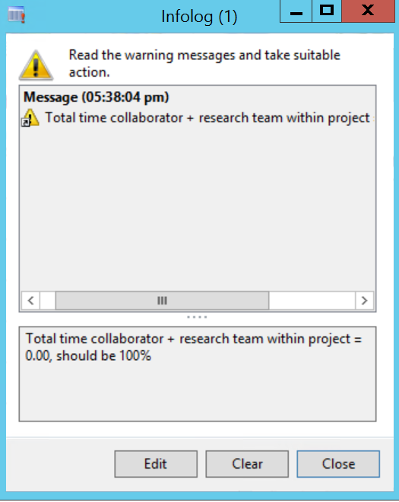
Generate Project From Manual Letter of Award
Notes:
When keying in the research proposal details, ensure that the % time within this project for all research team members and collaborators adds up to 100%. This form will not be able to close if the percentage does not equal to 100%.

Slide 33
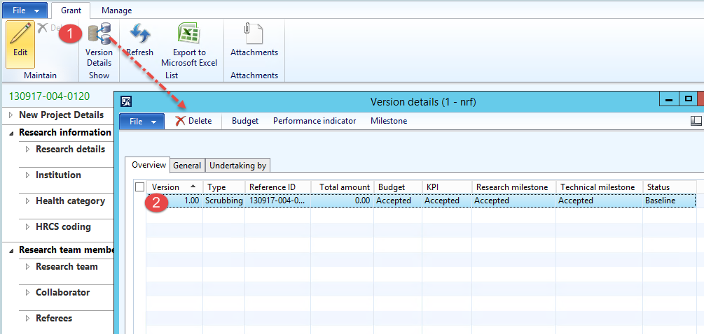
Generate Project From Manual Letter of Award
1
Click version details.
In this form, PM will key in the final approved version of the budget, performance indicators and milestones of the awarded project.
One version will be created for the Manual LOA, with status as Baseline.
2
Notes:
Version Details form can be opened when Lead PI info has been entered into the research team section of the proposal.

Slide 34
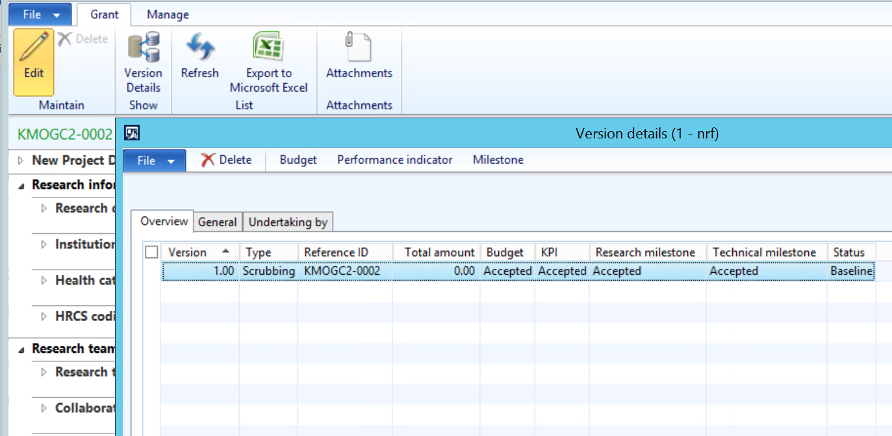
Generate Project From Manual Letter of Award
1
Click the Budget button to enter the proposal budget information.
1

Slide 35
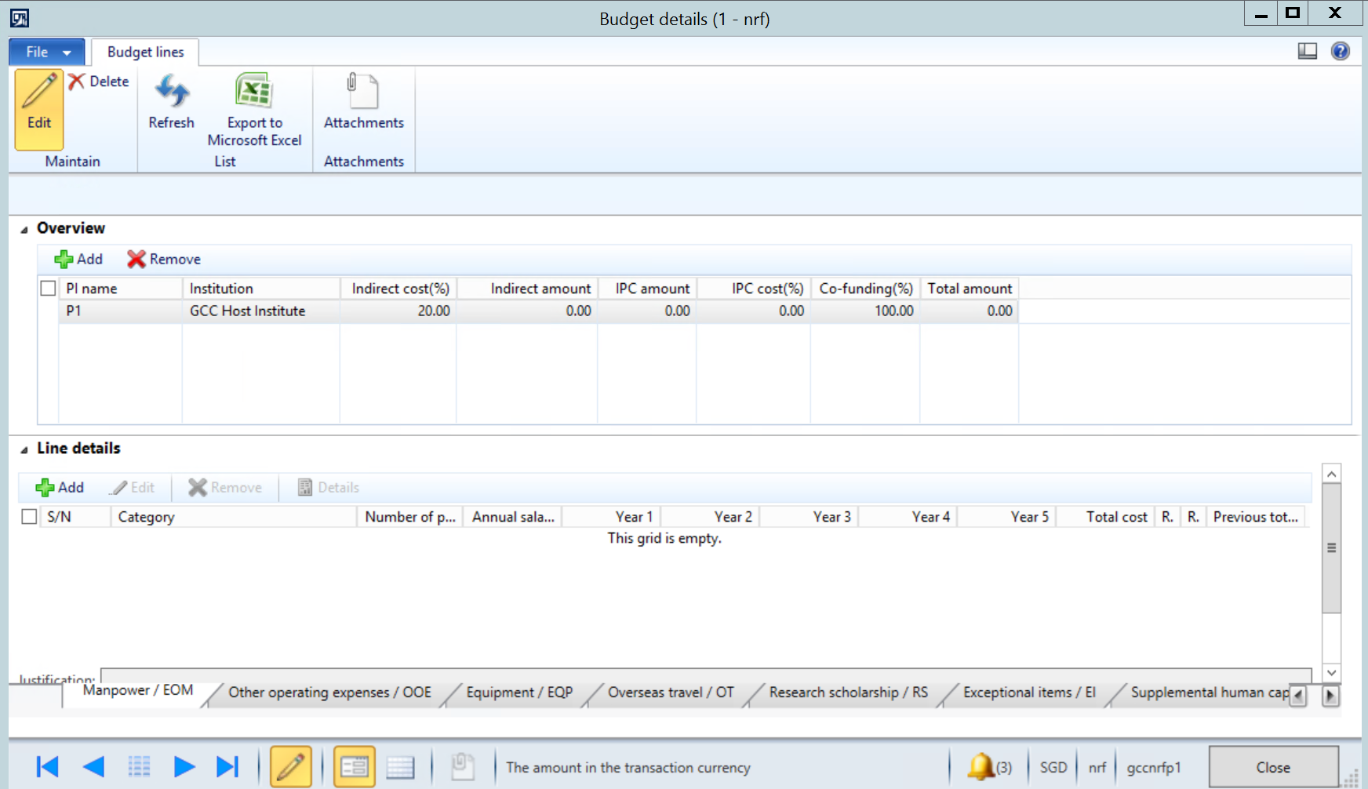
Generate Project From Manual Letter of Award
1
In the Overview section, click the Add button and select the Lead PI. The Institution will be automatically populated based on the institution specified in the Research Team details.
Enter the Indirect Cost (%), IPC cost (%) and Co-funding (%) based on the final approved budget version.
2
1
2

Slide 36
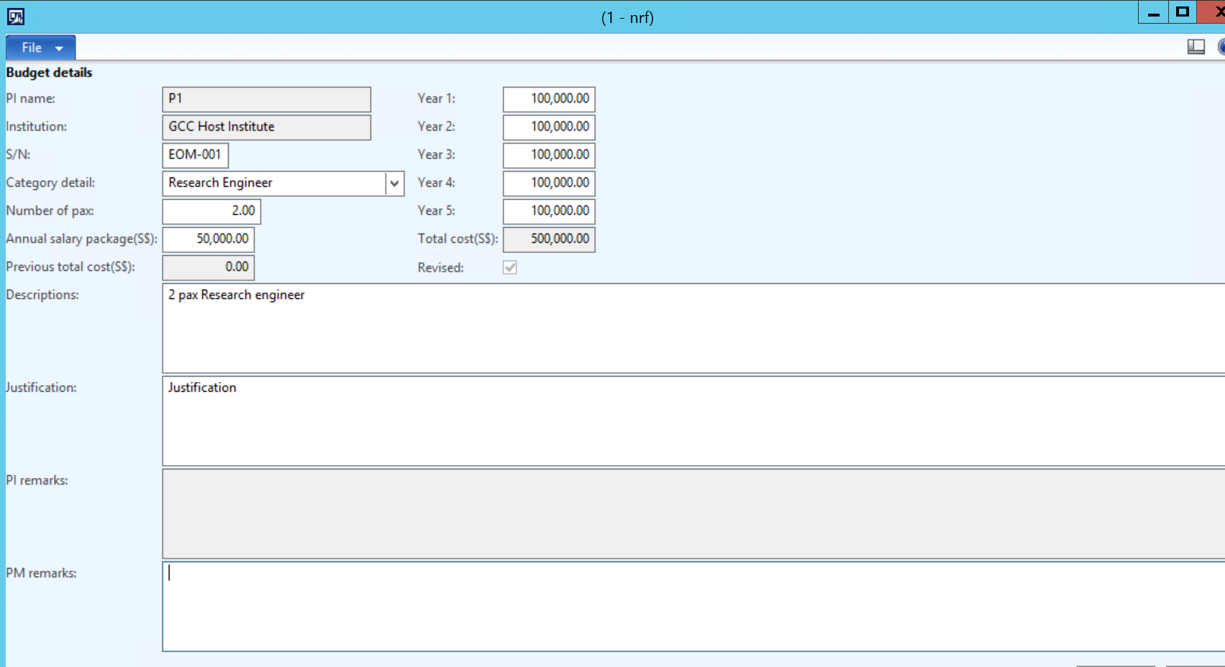
Generate Project From Manual Letter of Award
3
In the Line details section, click the Add button.
In the Budget details form, key in the required information for the vote and costs for each year.
Repeat the above steps for all the budget votes applicable to the proposal.
3

Slide 37
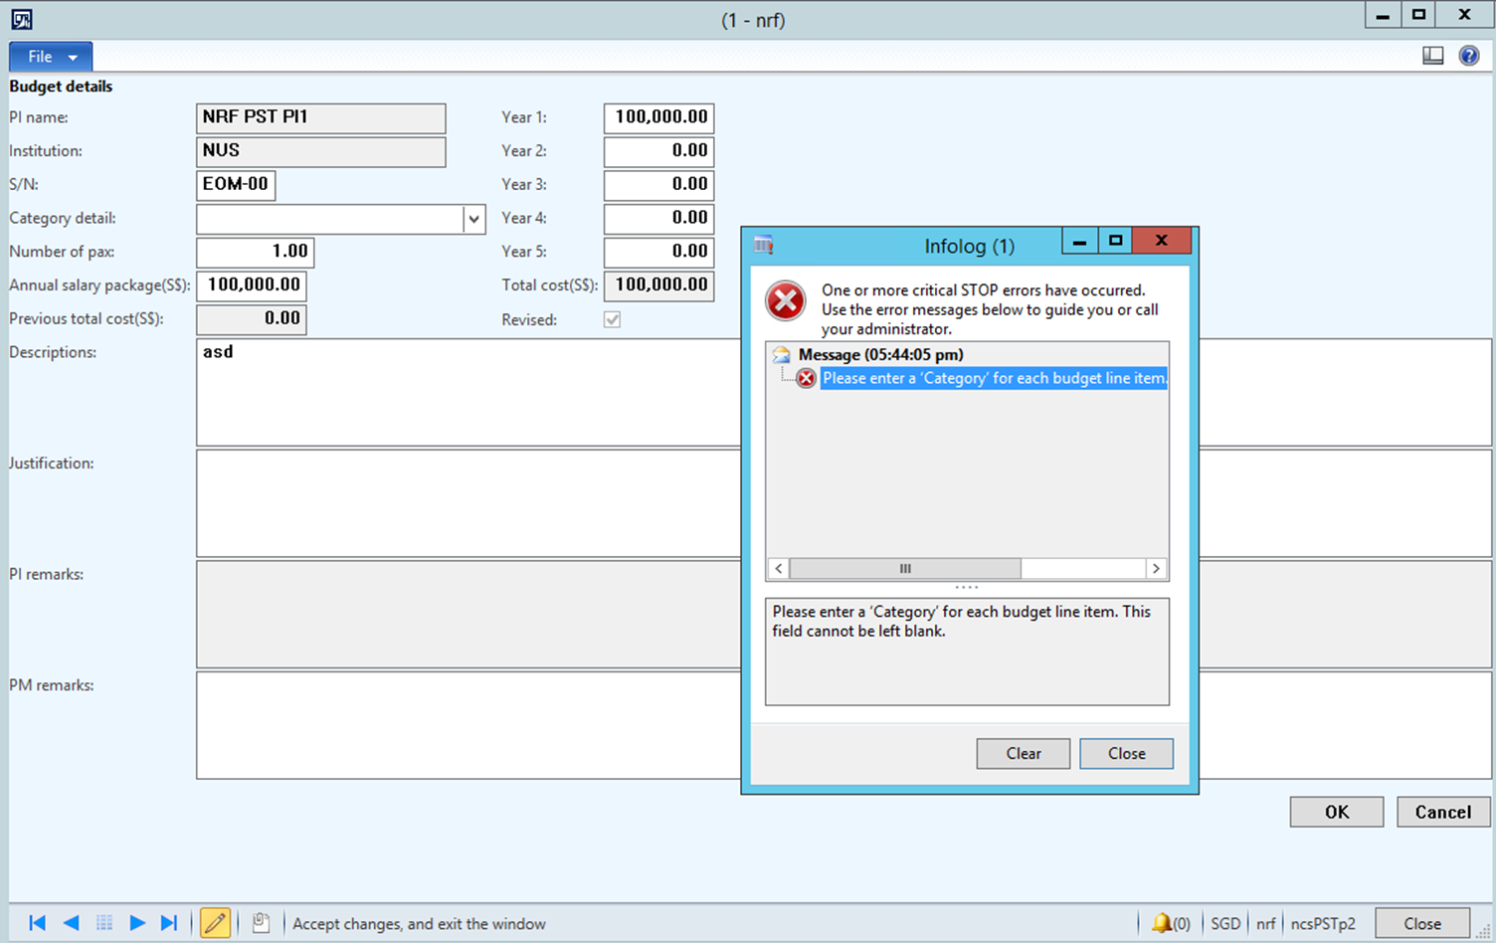
Generate Project From Manual Letter of Award
Notes:
An error message will be prompted if the “Category” for each line item is not inputted.

Slide 38
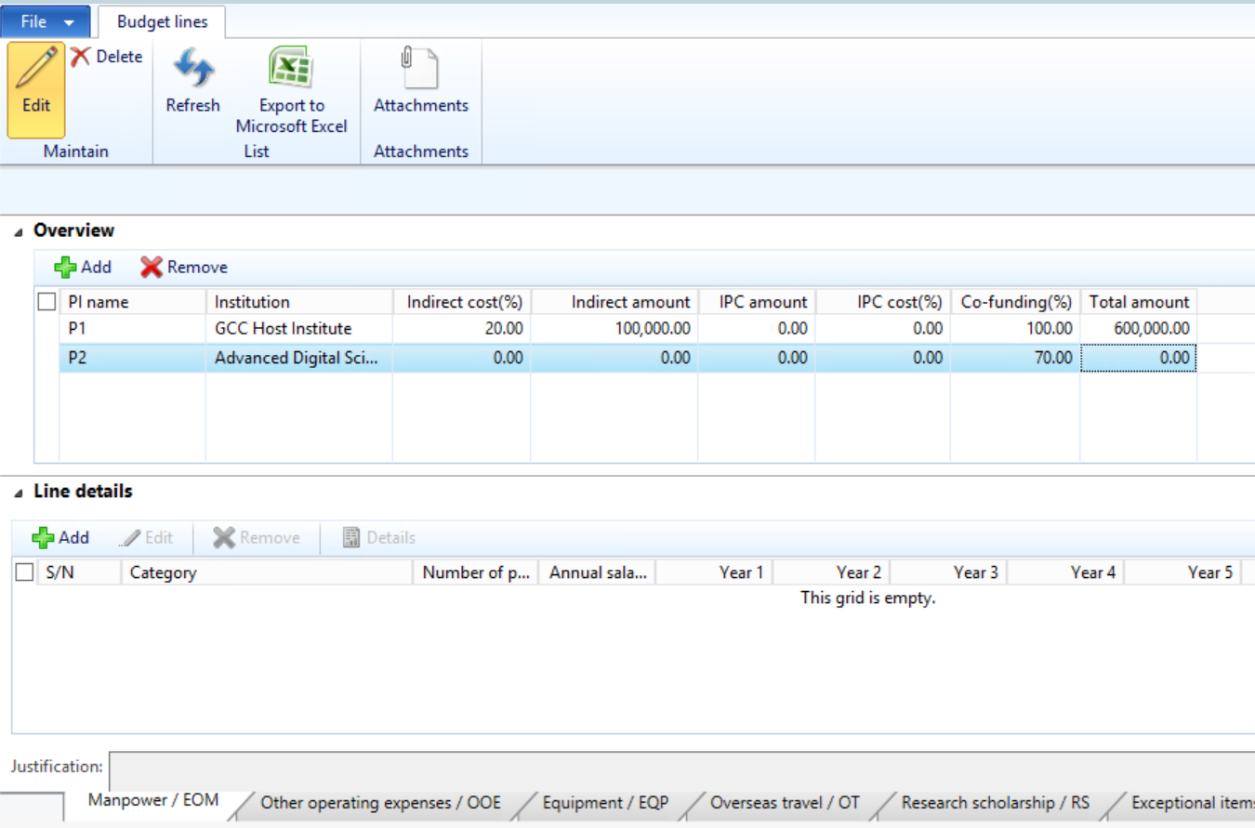
Generate Project From Manual Letter of Award
1
If the institutions making claims qualify for different levels of IDC and Co-funding, the appropriate levels should be indicated here, so that the Fund Requisitions will calculate the amounts correctly.
Click the Add button and select the relevant research team members to assign budget parameters (e.g. Lead PI, Team PI).
Enter the Indirect Cost (%)x, IPC cost(%) and Co-funding (%) based on the awarded budget.
2
1
2
Notes:
The Indirect amount will be automatically calculated for the eligible votes based on the IDC% entered.

Slide 39
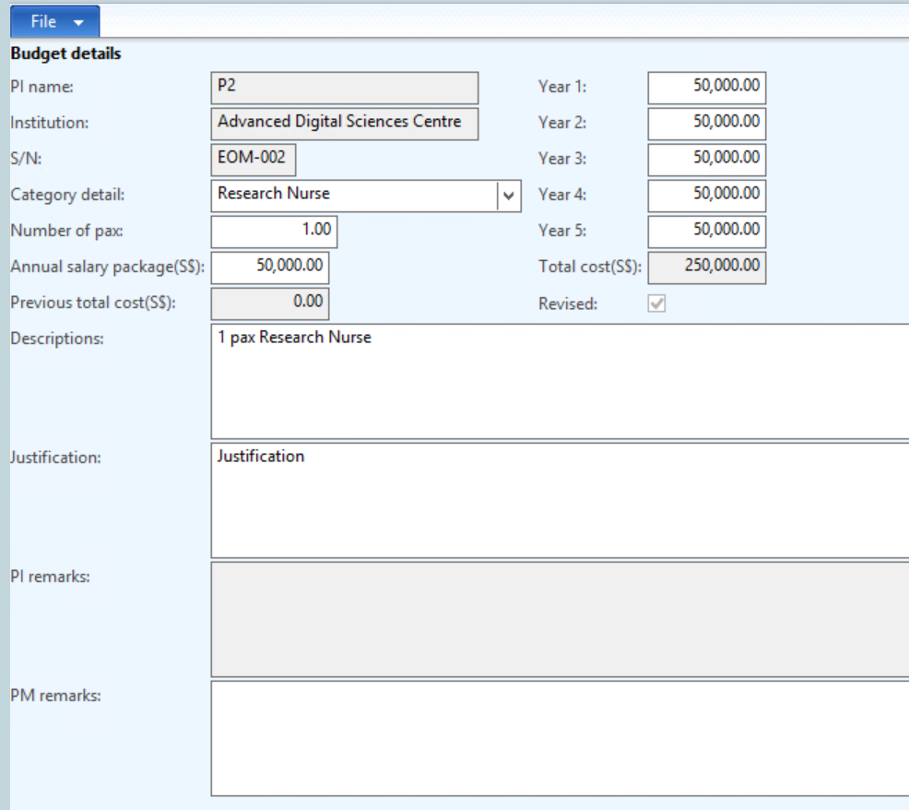
Generate Project From Manual Letter of Award
3
Click the Add button to enter the budget details for the other research team member.
Follow the same steps in page 36.
3

Slide 40
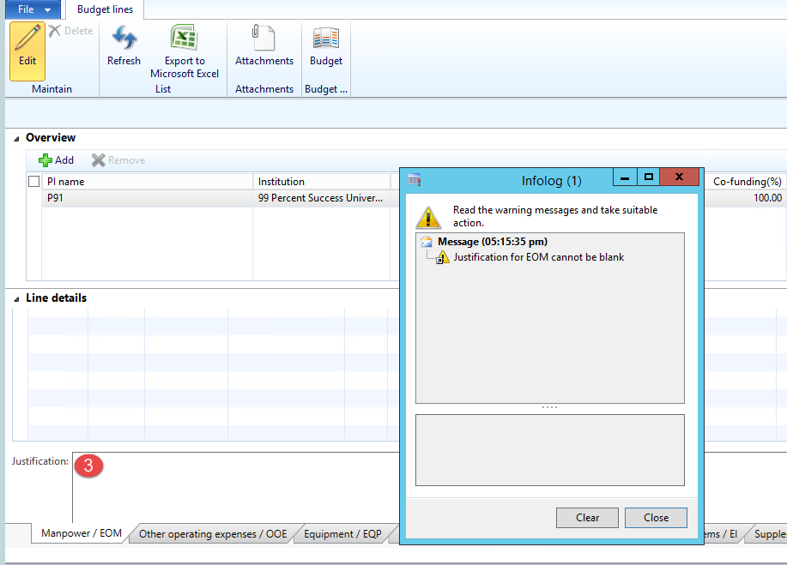
Generate Project From Manual Letter of Award
4
Ensure to key in the justification for each vote.
The form will not close, until all justification has been keyed in (if the project has any budget)
4

Slide 41
Generate Project From Manual Letter of Award
1
Click the Performance indicator button to enter the proposal’s KPI information.
1

Slide 42
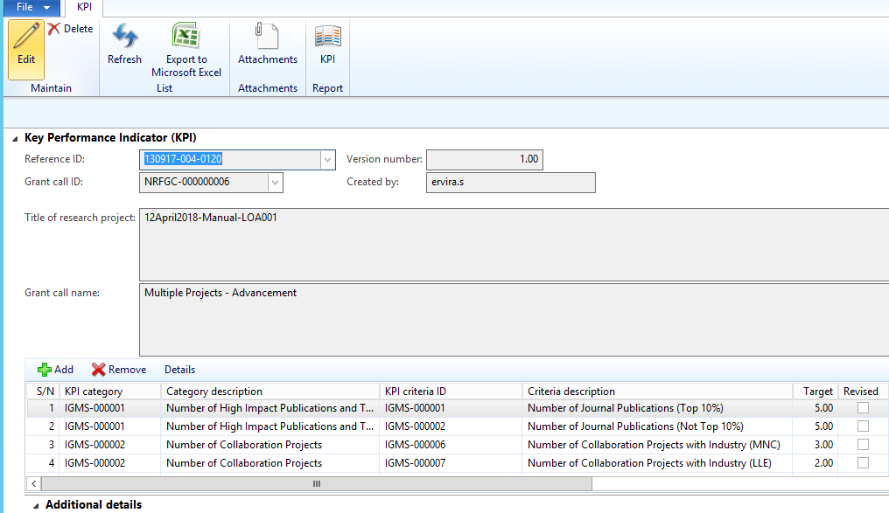
Generate Project From Manual Letter of Award
2
In the KPI section, select the latest version of KPIs for the awarded project.

Slide 43
Generate Project From Manual Letter of Award
1
Click the Milestone button to enter the proposal’s milestone information.
1

Slide 44
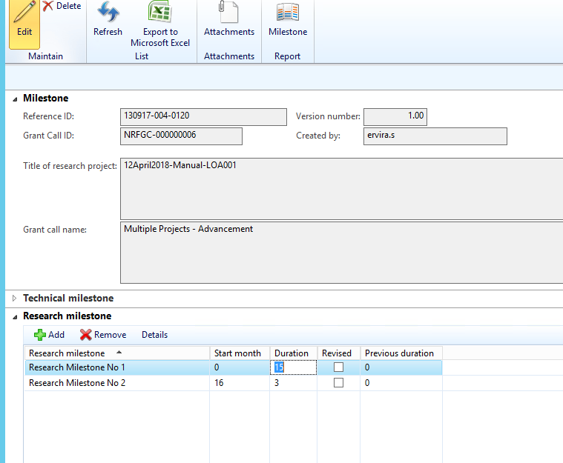
Generate Project From Manual Letter of Award
2
In the Milestone section, enter the Technical and Research milestones and the respective duration for the awarded project.

Slide 45
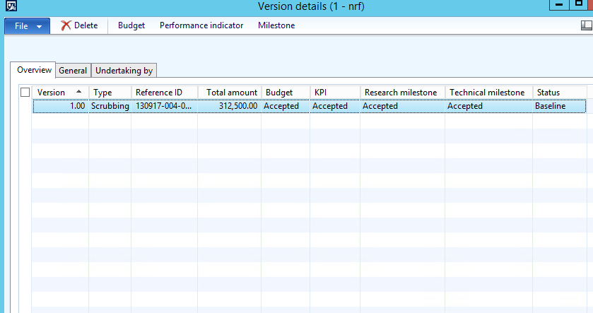
Generate Project From Manual Letter of Award
3
After the PM completes keying in the proposal section, the budgets, KPIs and milestones information will be updated on the Version detail form. Click refresh (or F5 button) to view the latest values.

Slide 46
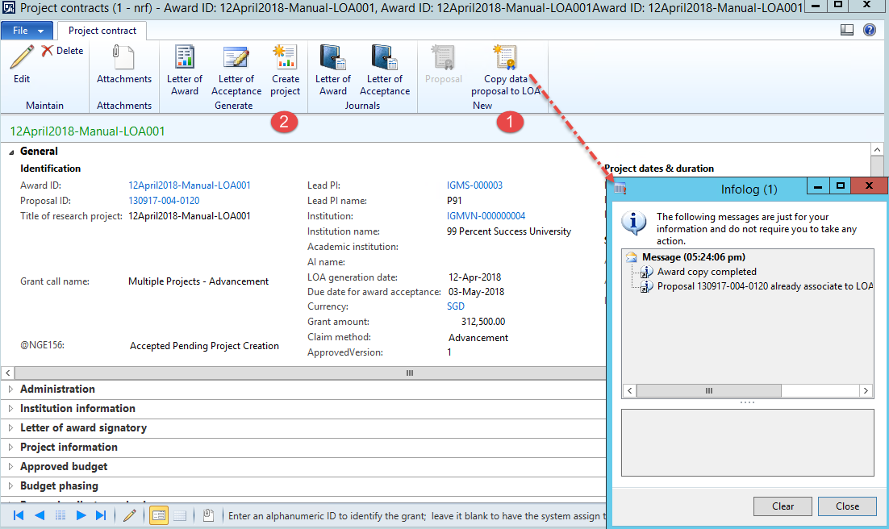
Generate Project From Manual Letter of Award
1
Once the PM completes the updates for the proposal section, close the Proposal form and switch back to the Letter of Award (LOA) form.
Click copy data proposal to LOA. Data from the proposal, such as Lead PI, Institution, Grant amount, etc. will be copied over to the LOA.
Click the Create project button to generate the Letter of Award to project.
2

